Slide 1

Group 15 Project Presentation
Chen Yan 1003620
Hua Guoqiang 1003783
Zhang Shaozuo 1003756
Chi Ziheng 1003030

Slide 2
Agenda
Project Architecture
Shortcomings and improvements
Frontend Implementation
Automation script
Backend Implementation
Analytics system
Implementation

Slide 3
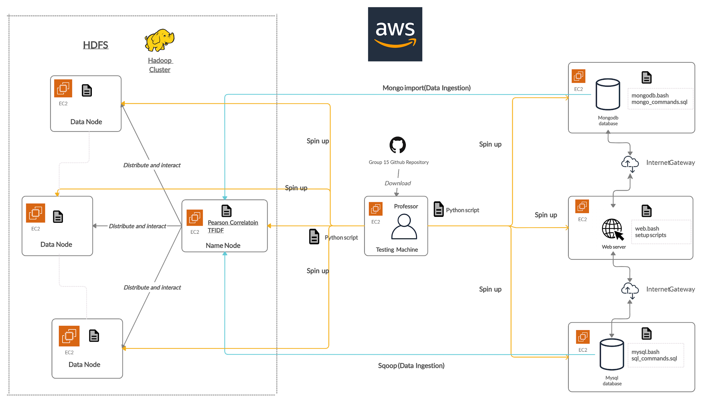
Project Architecture

Slide 4
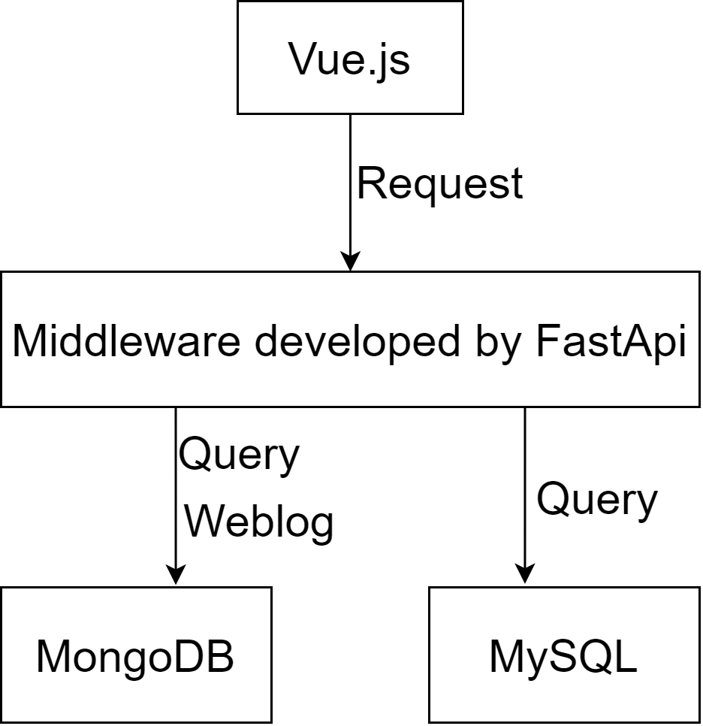
Frontend Implementation
Vue.js
1
FastApi
2
PyMongo
3
SQLAlchemy
4
Nginx
5

Slide 5
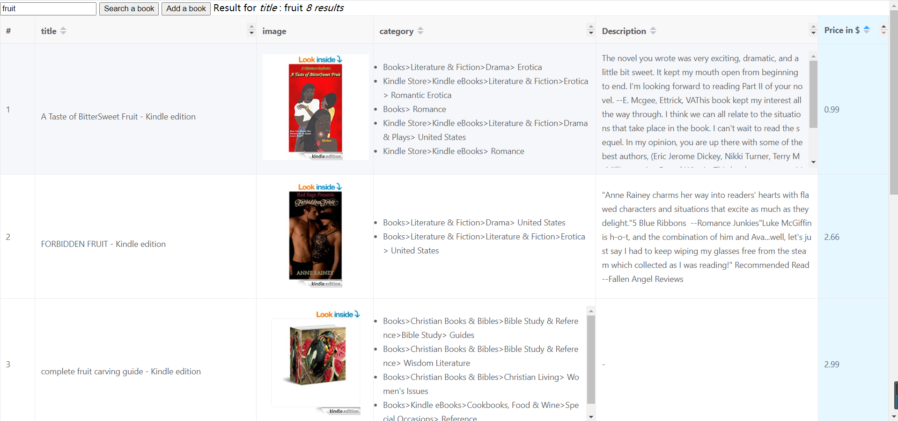

Slide 6
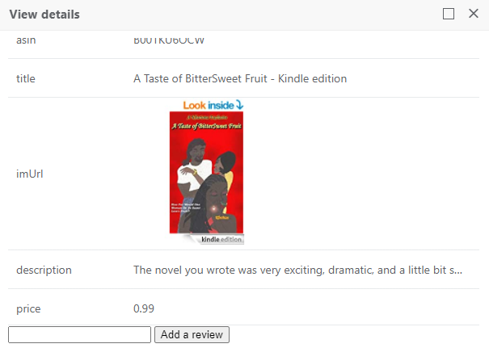

Slide 7
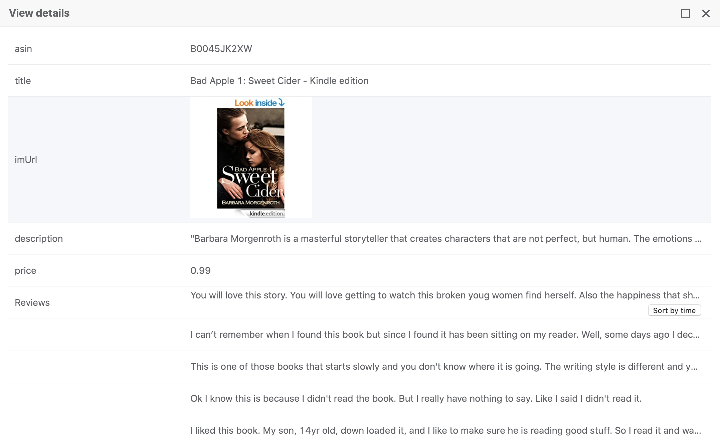
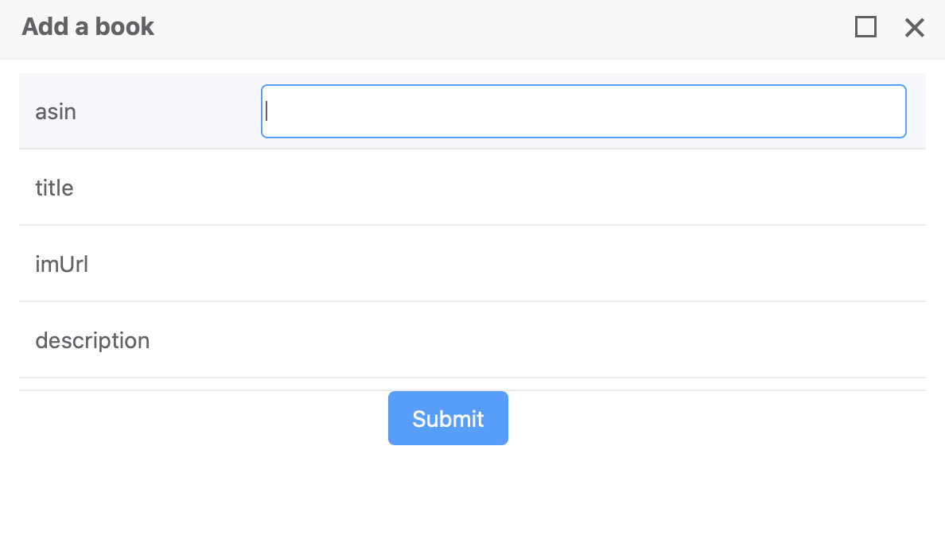

Slide 8
Backend Implementation
Automation Python Script
Non-Relational
Database
Relational Database
MongoDB setup bash script
MongoDB commands
Mysql setup bash script
Mysql commands script
MongoDB
Mysql

Slide 9
Database Automation Scripts
Mars
Mongodb setup bash script
Mysql setup bash script
Install Mongodb database
Configure Mongodb network to allow remote connection
Unzip kindle metadata and execute mongo commands
Load kindle metadata into Mongodb Collection
Install Mysql database
Create root user and test user with secure password
Configure Mysql network to allow remote connection
Execute Mysql commands script
Mongodb commands script
Mysql commands script
Create admin user against admin database with secure password
Create kindle_metadata database and collection to store metadata with assigned test_user and password to it
Create web_log database and collection to store web logs with assigned test_user and password to it
Create kindle_reviews database
Create table reviews to store kindle reviews with adding indexes to speed up performance
Load kindle reviews data into table

Slide 10
Analytics System Implementation
We set up a multi-node cluster with Hadoop 3.3.0 and Spark 3.0.1.
Analytics system
Hadoop
Spark
HDFS is used to store the data
Spark is used to perform analytics tasks

Slide 11
HDFS architecture
Our HDFS architecture contains namenode and 3 datanodes, you can also choose how many data nodes you want in the processing of running automation script.
Data Node
Name Node
Data Node
Data Node

Slide 12
Data Ingestion
MongoDB
MySQL
HDFS
HDFS
From MongoDB to HDFS
From RDBMs to HDFS
Connect the name node to the SQL server by sqoop, import kindle_reviews.csv to HDFS directly.
Connect the name node to the MongoDB server by mongoexport, import kindle_metadata.json to localhost and put the file into HDFS.

Slide 13
Analytics Automation Scripts
Mars
1.Set up a multi-node cluster in hadoop 3.3.0
3.Set up Sqoop and MongoDB
Install Java 8 ,SSH for each nodes
Set up public key from the namenode to data nodes
Distributing the configured library and install hadoop 3.3.0 for each nodes
Start Hadoop
Install Sqoop and MongoDB on namenode
Configure Sqoop and MongoDB
Load data from the production system (MySQL and MongoDB)
Store it in the hadoop distributed file system.
2.Set up Apache Spark framework
4.Call tfidf.py and pearson_correlation.py on namenode
Install Apache-Spark 3.0.1 on each nodes
Configure namenode and datanodes
Add dependencies to connect Spark
Launch namenode and datanodes
Initialising Sparksession
Call tfidf.py and pearson_correlation.py
Store TF-IDF value in several CSV files in reviews_tfidf_dir directory.
Stop Sparksession

Slide 14
Analytics Task 1: TF-IDF
1
1
Initialize a pyspark session in spark context.
2
2
Read the `kindle_reviews.csv` as `Pyspark.sql.Dataframe`.
3
3
Filter the rows without any review text and selecting columns `asin` and `reviewText`.
4
4
Apply Tokenizer to separate each word for each review
5
5
Apply Countvectorizer to fit and transform the new table to get the number of occurrence of each word and use build-in library IDF to get the tf-idf value,
6
6
Reorganize the output Dataframe in map-reduce fashion, apply Map function to map the word in vocabulary to its corresponding TF-IDF value.
7

Slide 15
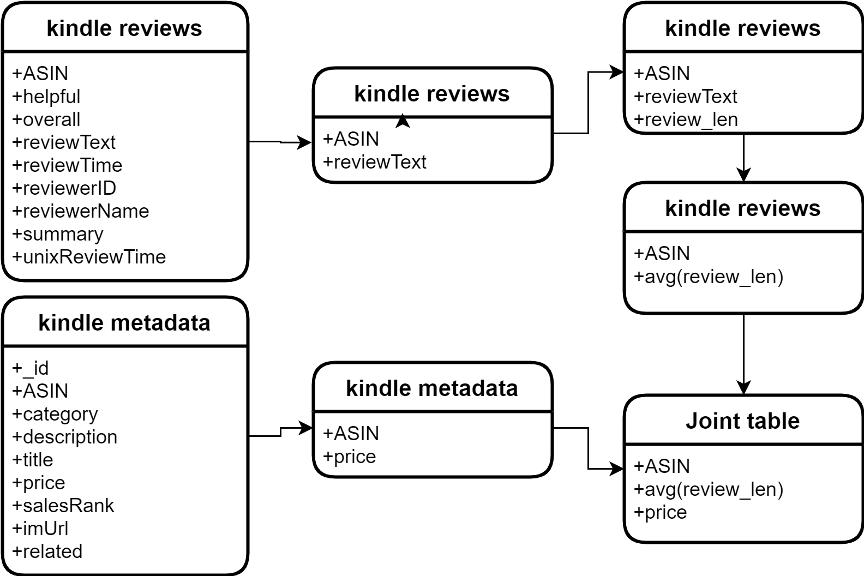
Analytics Task 2: Pearson Correlation- Data preprocessing
1
Read csv && json in HDFS
2
Select relative columns
Filter empty cells
3
Calculate each review length
4
Group by ASIN
Aggregate with
“mean ” function
5
Inner join
Dataframe to RDD
Notes:
Good evening prof, I will present how we implement Pearson Correlation between average review length and price
After finishing data injection, first step is data preprocessing,
We read the raw csv and json as sql dataframe, then we clean the datasets by select ONLY relative columns and filter empty cells. For kindle review dataframe, we calculate each review length, then group the table by the book ID which is ASIN and do aggregation with mean function.
Lastly, we perform inner join between the two tables and transform the dataframe to RDD for map-reduce jobs

Slide 16
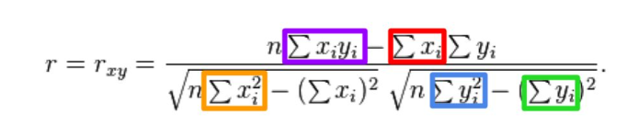
Analytics Task 2: Pearson Correlation- 5 Map-reduce jobs
Sum of every avg(review_len) x price
Sum of every avg(review_len)
Sum of every price
Sum of square of every avg(review_len)
Sum of square of every price
Notes:
So this is the equation we use to calculate Pearson Correlation value
The mapreduce task is subdivided into 5 jobs which is indicated by 5 different colors.
I will show a example of calculating sum of avery avg(review_len)x price in mapreduce fashion which is the job in purple.

Slide 17
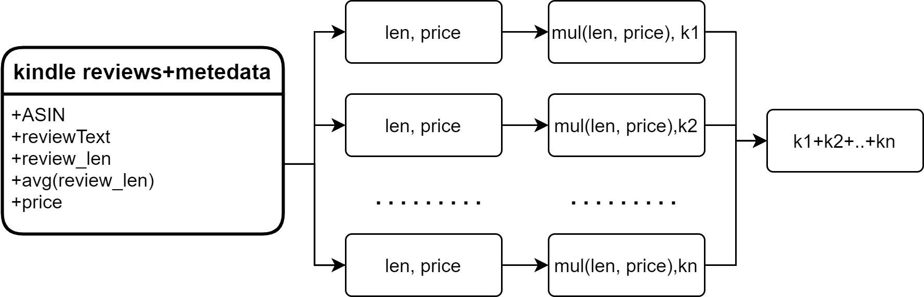
Analytics Task 2: Pearson Correlation - flowchart
5
Joint table as Input
6
Splitting
7
Mapping
8
Reducing
Notes:
After data preprocessing, we have the joint RDD as the input, Mapper function will calculate each multiplication of avg review len and price, the reducer function will sum up all the value
Last step is to Combine the outputs of all the map-reduce jobs according to the formula

Slide 18
Limitations and Potential Improvements
User login
Data Enrichment

Slide 19
Automation process
1
Use Boto3 to create instances and get instance IPs
2
Change IP configurations in shell scripts
3
Connect to instances using Paramiko
4
Upload shell scripts to instances
Boto3
Paramiko
5
Execute shell scripts and wait them to be done

Slide 20
Do you have any questions?

Slide 21
Thank you for listening!

